Slide 1

Faculty of Information Technology, Monash University

Slide 2
FIT2004: Algorithms and Data Structures
Week 5: Efficient Lookup Structures
Lecturer: Reza Haffari
These slides are prepared by M. A. Cheema and are based on the material developed by Arun Konagurthu and Lloyd Allison.

Slide 3

Things to note/remember
Anonymous Survey – closing in a couple of days
Give feedback at https://goo.gl/forms/1FkS1aGF74Ynz5CC3
Assignment 2 due 7 April 2019 - 23:59:00

Slide 4
Recommended Reading
Unit Notes – chapters 7 and 8
Hashing: http://www.csse.monash.edu.au/~lloyd/tildeAlgDS/Table/
Search Trees part of http://www.csse.monash.edu.au/~lloyd/tildeAlgDS/Tree/
Weiss “Data Structures and Algorithm Analysis in Java" (Chapter 5 and Chapter 4: Sections 4.1-4.4)
(FIT2004 S1/2016,

Slide 5
Outline
Introduction
Hash tables
Binary Search Tree
AVL Tree

Slide 6
Lookup Table
A lookup table allows inserting, searching and deleting values by their keys.
The idea of a lookup table is very general and important in information processing systems.
The database that Monash University maintains on students is an example of a table. This table might contain information about:
Student ID
Authcate
First name
Last name
Course(s) enrolled

Slide 7
Lookup Table
Elements of a table, in some cases, contain a key plus some other attributes or data
The key might be a number or a string (e.g., Student ID or authcate)
It is something unique that identifies unambiguously an element
Elements can be looked up (or searched) using this key. (Note, the element with no extra data/attributes is itself the key)

Slide 8
Sorting based lookup
Keep the elements sorted on their keys in an array (e.g., sort by student ID)
Searching:
O(log N)
use Binary search to find the key – O(log N)
Insertion:
O(N)
Use Binary search to find the sorted location of new element – O(log N)
Insert the new element and shift all larger elements toward right – O(N)
Deletion:
O(N)
Search the key – O(log N)
Delete the key – O(1)
Shift all the larger elements to left – O(N)
Is it possible to do better?
Yes! Hash tables and AVL trees!

Slide 9

Outline
Introduction
Hash tables
Introduction
Open Hashing
Closed Hashing
Linear Probing
Quadratic Probing
Double Hashing
Cuckoo Hashing
Binary Search Tree
AVL Tree

Slide 10
Direct-Addressing
Assume that we have N students in a class and the student IDs range from 1 to N. How can we store the data to delete/search/insert in O(1)-time?
Create an array of size N
Store a student with ID x at index x
Note: Each student is indexed at a unique index in the array
Searching the record with ID x
Return array[x]

Slide 11
Problem with Direct-Addressing
We assumed the keys (e.g., ID) range from 1 to N
What if this is not true?
IDs are not sequentially numbered (e.g., 26787973, 3167814 etc.)
Key is authcate (e.g., alpha3, beta5 etc.)
Direct-Addressing is not suitable if the Universe/Domain of the keys is large

Slide 12
Fixing the Problem with Direct-Addressing
Assume that we need to store the records for N students in a way to allow efficient lookup
Idea:
Create an array of size M
Store a student with key k at index k % M, e.g.,
if M =10 and student ID is 787973, store the student at index 787973 % 10 = 3
If the key is a string (e.g., authcate), convert it to a number k (e.g., using ASCII values) and then store at index k % M
Problem
Two students may get the same index (e.g., 787973 % 10 = 3 and 678143 % 10 = 3)
The above is a simplified idea behind hashing. The problem discussed above is called collision.

Slide 13
Hashing
A hash function maps key values onto an index position in an array of elements, i.e., index = hash(k) where hash() denotes the hash function.
The array is used as an implementation of the hash table.
Elements of the table can then be accessed directly using the hash key → hash index transformation, and then looking up the array at the position pointed by hash index. That is, hash index is the array index.
A problem with hashing is collisions – when two or more keys are mapped to same index position.
Can we avoid collisions by defining better hash functions?

Slide 14
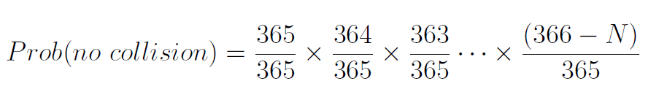
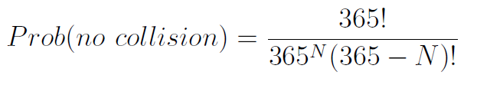
Understanding hash functions
We want to use a hash table for a class of N students
Assume that the hash function is based on birthdays (dd-mm), e.g., a student born on 01-Jan is hashed to index 1, 02-Jan on index 2, …, 31-Dec on 365.
How likely is that two students will be hashed to the same index, e.g., how likely is the collision?
Visit https://pudding.cool/2018/04/birthday-paradox/ for an interactive explanation of the birthday paradox

Slide 15
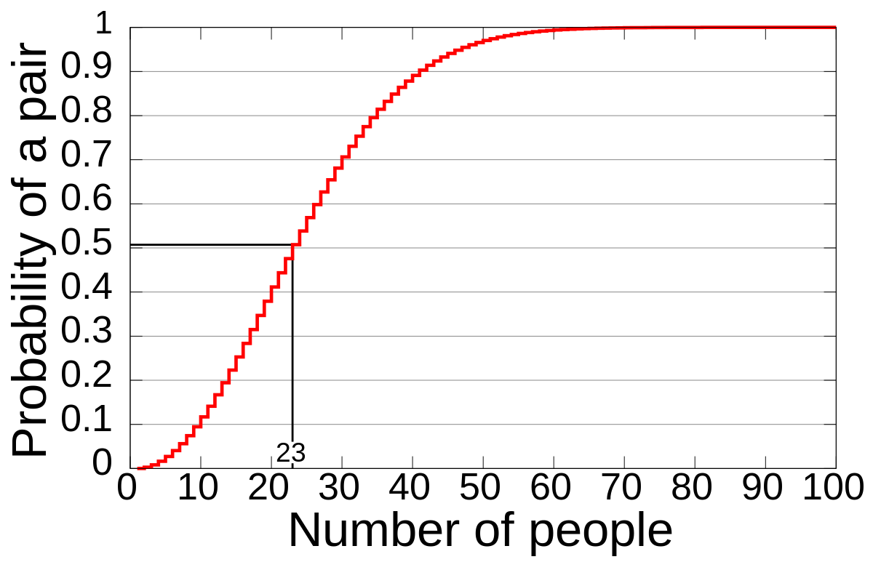
Probability of Collision
prob(collision) = 1 – prob(no collision)
The probability of collision for 23 people is ~ 50%
The probability of collision for 50 people is 97%
The probability of collision for 70 people is 99.9%

Slide 16
Take home message for hash functions
In this birthday paradox exercise we conducted in the class:
We considered a hash table was an array of size M equal to 365.
The birth date dd-mm is the key. A hash function f(dd-mm) mapped dd-mm into a number/index d between [1 … 365].
As the number of people (N) grows, the hash index f(dd-mm) has an increasing probability of collision.
The seemingly counterintuitive part was that N was NOT very large (in comparison with the table size M) for collisions to occur -- this is generally true for most hash functions!
In short
Given N keys and a hash table size of M, collisions will always occur unless M >> N

Slide 17
Some facts about hash functions
It is impossible to design a good hash function for all circumstances.
In general, designing good hash functions requires analysing the statistical properties of the key type.
The ideal hash function maps the actual key values uniformly onto the hash table indexes - Unfortunately the ideal is almost always unrealizable!
The surprising part is that the best hash functions are essentially pseudo-random functions.
However, collisions from these hash functions are, in almost all practical cases, inevitable.

Slide 18

Handling Collisions
Two strategies to address collisions!
Separate chaining or open hashing or closed addressing
Closed hashing or open addressing
Yes, naming is often so confusing …

Slide 19
Outline
Introduction
Hash tables
Introduction
Open Hashing
Closed Hashing
Linear Probing
Quadratic Probing
Double Hashing
Cuckoo Hashing
Binary Search Tree
AVL Tree

Slide 20
Open Hashing/Separate Chaining
If there are already some elements at hash index
Add the new element in a list at array[index]
Example: Suppose the hash table size M is 13 and hash function is key % 13.
Insert 29 → index = 29%13 = 3
Insert 38 → index = 38%13 = 12
Insert 16 → index = 16%13 = 3
Insert 15 → index = 15%13 = 2
Insert 42 → index = 42%13 = 3
Insert 25 → index = 25%13 = 12
Lookup/searching an element:
index = hash(key)
Search in list at Array[index]
Deleting an element:
Search the element
Delete it
42
16
25
15
29
38
0 | 1 | 2 | 3 | 4 | 5 | 6 | 7 | 8 | 9 | 10 | 11 | 12

Slide 21
Open Hashing/Separate Chaining
Assume that M is the size of hash table and N is the number of records already inserted.
Best-case Time complexity (assuming we are using a linked list)
Inserting an element
Searching an element
Deleting an element
Worst-case Time complexity
Inserting an element
Searching an element
Deleting an element
What if we use sorted array instead of a linked list?
Worst-case Time complexity:
Insertion
Search
Deletion
We could also use other structures such as AVL trees instead of linked list.
42
16
25
15
29
38
0 | 1 | 2 | 3 | 4 | 5 | 6 | 7 | 8 | 9 | 10 | 11 | 12

Slide 22
Closed Hashing (Open Addressing)
In closed-hashing, each index in the hash table contains at most one element.
How to avoid collision in this case?
Linear Probing
Quadratic Probing
Double Hashing
Cuckoo Hashing

Slide 23
Outline
Introduction
Hash tables
Introduction
Open Hashing
Closed Hashing
Linear Probing
Quadratic Probing
Double Hashing
Cuckoo Hashing
Binary Search Tree
AVL Tree

Slide 24
Linear Probing
In case of collision, sequentially look at the next indices until you find an empty index OR return fail if the hash table is full.
Example:
Insert 24 → index = 24 % 13 = 11
Insert 14 → index = 14 %13 = 1
Insert 37 → index = 37 % 13 = 11
Oops! Index 11 is occupied
Insert it at next index (11 + 1)%13 = 12
Insert 11 → index = 11 % 13 = 11
Oops! Index 11 is occupied
Check next index → (11 + 1)% 13 = 12
Oops! Index 12 is occupied
Check next index → (11 + 2)%13 = 0
Insert at index 0
// psuedocode for linear probing
index = hash(key)
i = 1
while array[index] is not empty and i != M
index = (hash(key) + i) % M
i ++
if i != M
insert element at array[index]
11
14
24
37
0 | 1 | 2 | 3 | 4 | 5 | 6 | 7 | 8 | 9 | 10 | 11 | 12

Slide 25
Linear Probing
Searching:
Look at index = hash(key). If element not found at index, sequentially look into next indices until
you find the element
or reach an index which is NIL (which implies that the element is not in the hash table)
or you have scanned all indices (which implies that the element is not in the hash table)
Worst-case Search Complexity?
Example: Search 53: (Index = 53 % 13 = 1)
Search 27: (Index = 27 % 13 = 1)
Deletion:
Search the element
Delete it
AND set array[index] = DELETED // This is important! Why?
Example:
Insert 40 in the array.
Delete 15 from the array
Search 40!
If the cell is not marked DELETED, the algorithm will return not found because array[3] is NIL.
14
1
15
30
53
40
23
0 | 1 | 2 | 3 | 4 | 5 | 6 | 7 | 8 | 9 | 10 | 11 | 12

Slide 26
Linear Probing
The previous example showed a search by increment of 1
In general, we can sequentially search with increment of a constant c, e.g.,
(hash(key) + c*i) % M
E.g., if c=3 and index = 2 is a collision, we will look at index 5, and then index 8, then 11 and so on …
The problem with linear probing is that collisions from nearby hash values tend to merge into big blocks, and therefore the lookup can degenerate into a linear O(N) search. This is called primary clustering.
14
53
15
30
44
40
23
0 | 1 | 2 | 3 | 4 | 5 | 6 | 7 | 8 | 9 | 10 | 11 | 12

Slide 27
Outline
Introduction
Hash tables
Introduction
Open Hashing
Closed Hashing
Linear Probing
Quadratic Probing
Double Hashing
Cuckoo Hashing
Binary Search Tree
AVL Tree

Slide 28
Quadratic Probing
Unlike linear probing that uses fixed incremental jumps, quadratic probing uses quadratic jumps.
Linear probing: index = (hash(key) + c*i) % M
Quadradtic probing: index = (hash(key) + c*i + d*i²) % M where c and d are constants
E.g., assume c = 0.5, d = 0.5
insert 40 → hash(40) = 40 % 13 = 1
i = 0 → index = 1 % 13 = 1
i = 1 → index = (1 + 0.5 + 0.5) % 13 = 2 // a jump of 1
i = 2 → index = (1 + 0.5*2 + 0.5*4) % 13 = 4 // a jump of 2
i = 3 → index = (1 + 0.5*3 + 0.5*9) % 13 = 7 // a jump of 3
i = 4 → index = (1 + 0.5*4 + 0.5*16) % 13 = 11 // a jump of 4
Quadratic probing is not guaranteed to probe every location in the table.
An insert could fail while there is still an empty location. However, hash tables are rarely allowed to get full (to get good performance).
The same probing strategy is used in the associated search and delete routine!
14
53
15
30
44
20
23
40
0 | 1 | 2 | 3 | 4 | 5 | 6 | 7 | 8 | 9 | 10 | 11 | 12

Slide 29
Problem with Quadratic Probing
Quadratic probing avoids primary clustering
However, if two elements have same hash index (e.g., hash(k1) = hash(k2)), the jumps are the same for both elements.
index = (hash(key) + c*i + d*i²) % M
E.g., hash(40) = hash(66) = 1
dashed red arrows show jump for inserting 40 (as in previous slides)
Blue arrows show jumps for inserting 66
This leads to a milder form of clustering called secondary clustering.
Is there a way to have different “jumping” for elements that hash to same indexing?
Yes! Double hashing – two hash functions
Even better, Cuckoo hashing – two hash functions and two hash tables
14
53
15
30
44
20
23
40
0 | 1 | 2 | 3 | 4 | 5 | 6 | 7 | 8 | 9 | 10 | 11 | 12

Slide 30
Outline
Introduction
Hash tables
Introduction
Open Hashing
Closed Hashing
Linear Probing
Quadratic Probing
Double Hashing
Cuckoo Hashing
Binary Search Tree
AVL Tree

Slide 31
Double hashing
Use two different hash functions: one to determine the initial index and the other two determine the amount of jump
Index = (hash1(key) + i*hash2(key)) % M
E.g., suppose hash1() is key % 13 and hash2() is key % 7
Insert 40 → hash1(40) = 1, hash2(40) = 5
i = 0 → index = 1
i = 1 → index = (1+5)%13 = 6
i = 2 → index = (1+10)%13 = 11
i = 3 → index = (1+ 15)%13 = 3
Insert 66 → hash1(66) = 1, hash2(66) = 3
i = 0 → index = 1
i = 1 → index = (1+3)%13 = 4
i = 2 → index = (1+6)%13 = 7
i = 3 → index = (1+ 9)%13 = 10
I = 4 → index = (1+ 12)%13 = 0
66
14
53
40
30
44
19
20
23
24
0 | 1 | 2 | 3 | 4 | 5 | 6 | 7 | 8 | 9 | 10 | 11 | 12

Slide 32
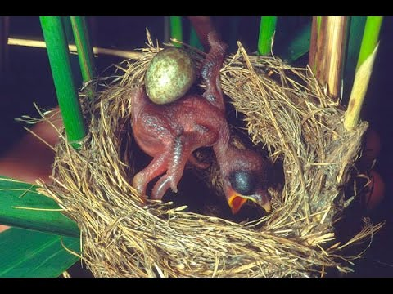
Outline
Introduction
Hash tables
Introduction
Open Hashing
Closed Hashing
Linear Probing
Quadratic Probing
Double Hashing
Cuckoo Hashing
Binary Search Tree
AVL Tree

Slide 33
Cuckoo hashing
None of the hashing schemes seen earlier can provide guarantee for O(1) searching in the worst-case.
Cuckoo Hashing:
Searching – O(1) in worst-case
Deletion – O(1) in worst-case
Insertion cost may be significantly higher – but expected cost is O(1)
Idea:
Use two different hash functions hash1() and hash2() and two different hash tables T1 and T2 of possibly different sizes.
hash1() determines the index in T1 and hash2() determines the index in T2.
Each key will be indexed in only one of the two tables
Handle collision by “Cuckoo approach”
kick the other key out to the other table until every key has its own “nest” (i.e., table)
T1
Key%13
0 | 1 | 2 | 3 | 4 | 5 | 6 | 7 | 8 | 9 | 10 | 11 | 12
T2
Key%7
0 | 1 | 2 | 3 | 4 | 5 | 6

Slide 34
Cuckoo hashing
Insert 23
Hash1(23) → 23%13 →10
Insert 36
Hash1(36) → 36%13 → 10
Hash2(23) → 23%7 →2
Insert 114
Hash1(114) → 114%13 → 10
Hash2(36) → 36%7 → 1
Insert 49
Hash1(49) → 49%13 → 10
Hash2(114) → 114%7 → 2
Hash1(23) → 23%13 → 10
Hash2(49) → 49%7 → 0
Insert 23 at T1[10]
Insert 36 at T1[10] and kick away 23 to T2
Insert 23 at T2[2]
Insert 114 at T1[10] and kick away 36 to T2
Insert 36 at T2[1]
Insert 49 at T1[10] and kick away 114 to T2
Insert 114 at T2[2] and kick away 23 to T1
Insert 23 at T1[10] and kick away 49 to T2
Insert 49 at T2[0]
T1
23
Key%13
0 | 1 | 2 | 3 | 4 | 5 | 6 | 7 | 8 | 9 | 10 | 11 | 12
T2
Key%7
36
114
49
0 | 1 | 2 | 3 | 4 | 5 | 6

Slide 35

Cuckoo hashing
Insert 140
Hash1(140) →140%13 → 10
Hash2(23) → 23%7 → 2
Hash1(114) → 114%13 → 10
Hash2(140) → 140%7 → 0
Hash1(49) → 49%13 → 10
Hash2(114) → 114%7 → 2
…
Cuckoo Hashing gives up after MAXLOOP number of iterations
Uses new hash functions (and may resize two tables) and hashes everything again
Thus insertion may be quite costly
Insert 140 at T1[10] and kick away 23 to T2
Insert 23 at T2[2] and kick away 114 to T1
Insert 114 at T1[10] and kick away 140 to T2
Insert 140 at T2[0] and kick away 49 to T1
Insert 49 at T1[10] and kick away 114 to T2
Insert 114 at T2[2] and kick away 23 to T1
T1
23
Key%13
0 | 1 | 2 | 3 | 4 | 5 | 6 | 7 | 8 | 9 | 10 | 11 | 12
T2
49
36
114
Key%7
140
0 | 1 | 2 | 3 | 4 | 5 | 6

Slide 36
Cuckoo hashing
Observation: A key is either at index= hash1(key) in T1 or at index = hash2(key) in T2
Searching:
Look at T1[ hash1(key)] and T2[hash2(key)]
E.g.,
Search 36
36%13 →10 Look at T1[10]. Not there, so look in T2
36%7 → 1 Look at T2[1]. Found!!!
Search 10
10%13 →10 Look at T1[10]. Not there, so look in T2
10%7 → 3 Look at T2[3]. Not found!!!
What is worst-case time complexity for searching?
O(1)
T1
23
Key%13
0 | 1 | 2 | 3 | 4 | 5 | 6 | 7 | 8 | 9 | 10 | 11 | 12
T2
49
36
114
Key%7
0 | 1 | 2 | 3 | 4 | 5 | 6

Slide 37
Cuckoo hashing
Observation: A key is either at index= hash1(key) in T1 or at index = hash2(key) in T2
Deletion:
Search key
Delete it if found
What is worst-case time complexity for deletion?
O(1)
What about insertion? (NON-EXAMINABLE)
In the worst-case, it could be arbitrarily bad
It has been shown that the expected cost to insert N items is O(N)
T1
23
Key%13
0 | 1 | 2 | 3 | 4 | 5 | 6 | 7 | 8 | 9 | 10 | 11 | 12
T2
49
36
114
Key%7
0 | 1 | 2 | 3 | 4 | 5 | 6

Slide 38
Summary of Hashing
It is hard to design good hash functions.
The examples shown in the lecture show very simple hash functions.
In practice hash tables give quite good performance (e.g., O(1))
Hash tables are disordered data structures. Therefore certain operations become expensive.
Find maximum and minimum of a set of elements (keys).

Slide 39


Outline
Introduction
Hash tables
Binary Search Tree
AVL Tree

Slide 40
Binary Search Tree (BST)
The empty tree is a BST
If the tree is not empty
the elements in the left subtree are LESS THAN the element in the root
the elements in the right subtree are GREATER THAN the element in the root
the left subtree is a BST
the right subtree is a BST
Note! Don't forget last two conditions!
24
20
28
15
22
26
30
14
17
21
23

Slide 41
Searching a key in BST
// BST implemented here as a tree data structure
// T = fork(e, L, R)
function search(key,T)
if (T == nilTree)
return false // not present!
else if ( key < e ) // search x in Left subtree
search( key , L )
else if ( key > e ) // search x in Right subtree
search( key , R )
else return true
Search 21
24
20
28
15
22
26
30
14
17
21
23

Slide 42
Insert a key x in BST
// BST implemented here as a tree data structure
// T = fork(e, L, R)
function insert( x , T )
if (T == nilTree) // Insert here as leaf node
T = fork( x , nilTree , nilTree )
else if ( x < e ) // Traverse and insert ...
insert( x, L ); // along the Left subtree
else if (x > e ) // Traverse and insert ...
insert( x , R ) // along the Right subtree
else // x == e
... it depends ... // e.g., store as a link list/sorted array at e
return
Insert 27
24
20
28
15
22
26
30
14
17
21
23
27

Slide 43
Delete a key from BST
First lookup key in BST
If the key node has no children // Case 1
delete the key node
set subtree to nil
Delete 27
24
20
28
15
22
26
30
14
17
21
23
27

Slide 44
Delete a key from BST
First lookup key in BST
If the key node has one child // Case 2
delete the key node
replace the key node with its child
Delete 28
24
20
28
15
22
26
14
17
21
23
25
27

Slide 45
Delete a key from BST
First lookup key in BST
If the key node has two children // Case 3
Find the largest node N in left subtree (or the smallest node N in right subtree)
Replace key node value with the value of N
Delete N
Delete 24
24
20
28
15
22
26
30
23
14
17
21
23
27

Slide 46
Delete a key from BST
First lookup key in BST
If the key node has two children // Case 3
Find the largest node N in left subtree (or the smallest node N in right subtree)
Replace key node value with the value of N
Delete N
Delete 24
24
20
28
22
26
15
26
30
14
17
21
23
27

Slide 47
Worst-case of BST
A BST is not a balanced tree and, in worst case, may degenerate to a linked list
E.g., when elements are inserted in sorted order (ascending or descending) – insert 24, 20, 15, 14.
Worst-case time complexity
Insert
Delete
Search
Can we improve the performance by keeping the tree balanced?
Yes – AVL Tree does that
24
20
15
14

Slide 48

Outline
Introduction
Hash tables
Binary Search Tree
AVL Tree
Introduction
Balancing AVL tree
Complexity Analysis
Binary Search Tree
AVL Tree

Slide 49
AVL Trees: Introduction
Adelson-Velskii Landis (AVL) tree is a height-balanced BST
The heights of left and right subtrees of every node differ by at most one
If at any time they differ by more than one, rebalancing is done to restore this property.
Is the following tree balanced according to the above definition?
Is it still balanced after deleting 25?
Is it still balanced after deleting 17?
Is it still balanced after deleting 22?
24
20
26
25
27
15
22
14
17

Slide 50
Defining AVL Tree
T is an AVL Tree if T is a binary search tree, and . . .
Every node of T has a balance_factor 1,0, or -1
Balance factor = height(L) – height(R)
24
1
1
20
26
-1
0
27
1
15
22
0
0
14

Slide 51
Outline
Introduction
Hash tables
Binary Search Tree
AVL Tree
Introduction
Balancing AVL tree
Complexity Analysis

Slide 52
Balancing AVL Tree after insertion/deletion
The tree becomes unbalanced after deleting 22.
The tree may also become unbalanced after insertion.
How to balance it after deletion/insertion?
We have four possible scenarios:
Left-left
Left-right
Right-right
Right-left
Balance factors
24
1
2
1
26
-1
20
0
27
1
15
0
22
0
14

Slide 53
Left-Left Case
A left-left case occurs when
A node has a balance factor +2; and
Its left child has a balance factor 0 or more
24
2
1
26
0
20
1
15
22
0
0
14

Slide 54
Handling Left-left case
Note that all elements in B are greater than 20 and smaller than 24. Therefore, it can be made a left child of 24 after rotation.
2
24
20
A
0 or 1
20
15
B
24
B
15
A
D
C
D
C

Slide 55
Example: Left-left case
2
X
Y
0 or 1
Y
A
Z
X
Z
B
D
C
B
A
D
C
0
24
2
20
1
0
1
24
0
20
26
15
1
15
0
14
0
0
22
0
22
26
0
14

Slide 56
Left-Right Case
A left-right case occurs when
A node has a balance factor +2; and
Its left child has a negative balance factor
24
2
-1
26
0
20
0
14
22
0
0
21
23
0

Slide 57
Handling Left-right case
Left Right Case
Convert Left Right case to Left Left case by rotating 20.
Handle Left Left case as described earlier
Note that all elements in C are smaller than 20 and greater than 15. Therefore, it can be made a right child of 15 after rotation.
2
24
24
A
A
-1
15
20
B
D
15
20
C
C
B
D
C

Slide 58
Example: Left-right case – Step 1
2
X
X
A
Z
A
-1
Y
Y
B
D
Z
C
B
D
C
2
24
2
24
-1
0
1
22
26
0
20
26
0
0
0
14
20
23
22
0
14
21
This is a left-left case now
0
21
23
0
0
0

Slide 59
Example: Left-right case – Step 2
2
X
Y
22
0 or 1
Y
A
24
Z
X
20
Z
B
D
C
B
A
23
26
14
21
D
C
2
24
2
24
-1
0
1
22
26
0
20
26
0
0
0
14
20
23
22
0
14
21
0
This is a left-left case now
0
21
23
0
0

Slide 60
Right-Right Case
A right-right case occurs when
A node has a balance factor -2; and
Its right child has a balance factor 0 or less
-2
23
0
26
0
20
1
28
-1
25
0
0
24
34

Slide 61
Handling right-right case
Note that all elements in C are smaller than 15 and greater than 10. Therefore, it can be made a right child of 10 after rotation.
-2
10
15
D
15
0 or -1
10
C
20
C
20
C
B
A
0
D
B
A

Slide 62
Example: right-right case
-2
X
Y
D
Y
0 or -1
X
Z
C
Z
0
D
C
B
A
B
A
26
1
23
-2
-1
23
28
-1
0
20
26
0
-1
0
20
1
25
0
34
1
25
28
0
0
24
0
24
34

Slide 63
Right-Left Case
A right-left case occurs when
A node has a balance factor -2; and
Its right child has a positive balance factor
-2
23
0
26
1
20
1
28
0
25
0
24

Slide 64
Keeping AVL Tree Balanced
Right Left Case
Convert Right Left Case to Right Right case by rotating 15
Handle Right Right case as earlier
Note that all elements in B are greater than 15 and smaller than 20. Therefore, it can be made a left child of 20 after rotation.
-2
10
10
D
20
1
D
15
A
15
0
C
B
20
C
B
B
A

Slide 65
Outline
Introduction
Hash tables
Binary Search Tree
AVL Tree
Introduction
Balancing AVL tree
Complexity Analysis

Slide 66
Search, Insertion, Deletion in AVL Tree
Search algorithm in AVL Tree is exactly the same as in BST
Worst-Case time complexity
O(log N) because the tree is balanced
Insertion/Deletion in AVL Tree
Insert/Delete the element in the same way as in BST (as described earlier)
Balance the tree if it has become unbalanced (as described earlier)
Worst-case insertion/deletion time complexity: ??

Slide 67
Complexity of Balancing AVL tree after insertion/deletion
Tree is balanced before insertion/deletion
An insertion/deletion can affect balance factor of at most O(log N) nodes
E.g., Insert 13
24
1
1
20
26
-1
0
27
1
15
22
0
0
14

Slide 68
Complexity of Balancing AVL tree after insertion/deletion
Tree is balanced before insertion/deletion
An insertion/deletion can affect balance factor of at most O(log N) nodes
E.g., Insert 13
The balancing is done from bottom to top
E.g., first balance node 15 and so on
24
2
2
20
26
-1
0
27
2
15
22
0
1
14
0
13

Slide 69
Complexity of Balancing the AVL Tree
The tree is balanced in a bottom up fashion starting from the lowest node which has a balance factor NOT in {0, 1, -1}
Balancing at each node takes constant time (1 or 2 rotations)
We need to balance at most O(log N) nodes in the worst-case
So total cost of balancing after insertion/deletion is O(log N) in worst-case
10
-2
10
-2
E
2
E
24
20
0
A
1
20
F
15
24
0
B
0
15
A
D
C
B
D
C

Slide 70
Summary
Take home message
Hash tables provide O(1) look up in practice (although the worst-case complexity may still be O(N))
AVL Trees guarantee worst-case time complexity of O(Log N)
Things to do (this list is not exhaustive)
Read more about hash tables and hash functions
Practice balancing AVL trees using pen and paper
Implement BST and AVL trees
Coming Up Next
Retrieval Data Structures for Strings

Slide 71

Happy Easter!

